Slide 1
PROJ 216 Software Project Concepts
Day 2

Slide 2
“Every minute you spend in planning saves 10 minutes in execution; this gives you a 1,000 percent return on energy!”
— Brian Tracy

Slide 3
Topics
Project Planning
Work Breakdown Structure (WBS)
Project Schedule (Gantt Chart)
Using MS Project
Project Cost

Slide 4
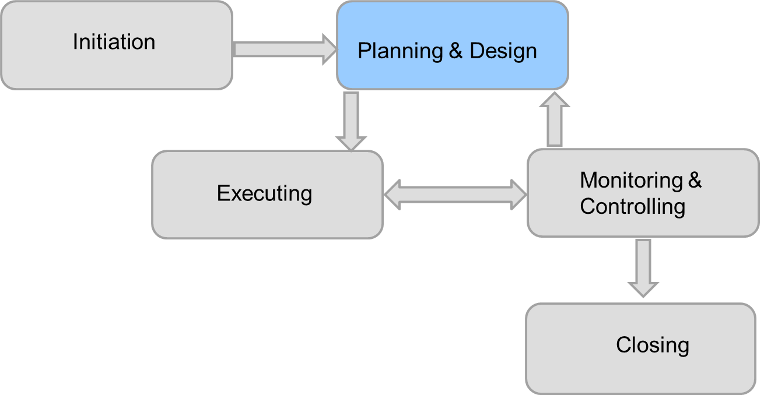
Project Planning

Slide 5
“If you fail to plan, you are planning to fail.”
— Benjamin Franklin

Slide 6
Project Planning
Collect requirements -> requirements document
Define scope -> project scope statement
Create Work-Breakdown-Structure -> WBS
Develop schedule -> project schedule (Gantt chart)
Estimate cost and determine budget -> preliminary project budget
Develop resource plan -> resource plan
Develop communications plan –> communications plan
…

Slide 7
Collecting Requirements
A requirement is “a condition or capabilities that must be met by a project, or present in the product, service, or result to satisfy an agreement or other formally imposed specification” (PMBOK® Guide, Fifth Edition, 2013)
It is important to use an iterative approach to defining requirements since they are often unclear early in a project

Slide 8
Methods of Collecting Requirements
Interviews
Focus groups and facilitated workshops
Questionnaires and surveys
Observation
Prototyping
Benchmarking
What are the strengths / weaknesses of each method?

Slide 9
Scope and Deliverables
Scope is all the work involved in creating the product
Scope is defined based on the requirements document
As the time progresses, scope should become more clear and specific
A deliverable is a product produced as part of a project, such as hardware or software, planning documents, or meeting minutes

Slide 10
Work Breakdown Structure (WBS)
A WBS is a deliverable-oriented grouping of the work involved in a project that defines the total scope of the project
WBS is a foundation document that provides the basis for planning and managing project schedules, costs, resources, and changes
Decomposition is subdividing project deliverables into smaller pieces
A work package is a task at the lowest level of the WBS

Slide 11
Approaches to Develop WBS
Top-down – start with largest items of the project and break them down
Bottom-up – start with specific tasks and roll them up
Review WBS of similar projects and tailor to your project
Make sure to include project management tasks
Make sure to include tasks that do not directly produce a deliverable, but are necessary, like consulting the client or testing
Organize your WBS:
By product, or
By phase

Slide 12
Tips for Creating WBS
A unit of work should appear at only one place in the WBS
The work content of a WBS item is the sum of the WBS items below it
A WBS item is the responsibility of only one individual, even though many people may be working on it
The WBS must be consistent with the way in which work is going to be performed
All team members should be involved in creating WBS to ensure consistency and buy-in
Provide additional documentation (WBS dictionary) to ensure accurate understanding of the work content

Slide 13
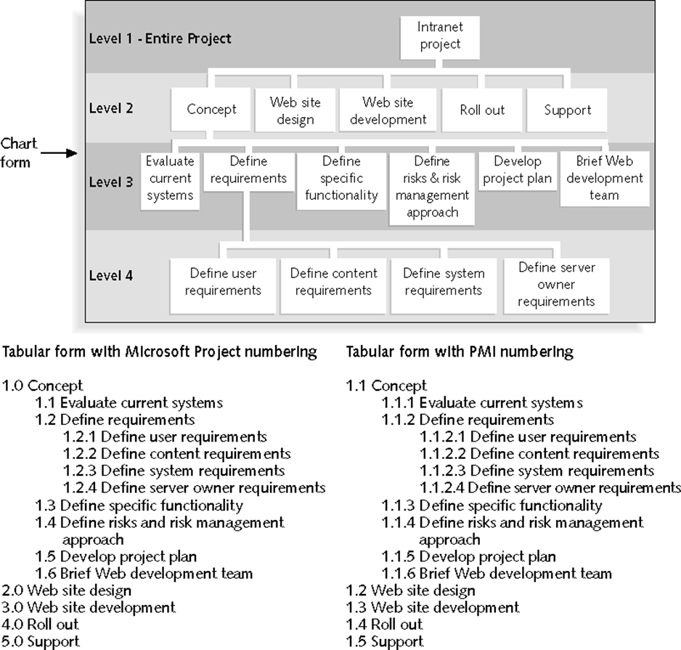
Sample WBS Organized by Phase
[Schwalbe 2016]

Slide 14
WBS Examples
https://www.workbreakdownstructure.com/work-breakdown-structure-examples

Slide 15
WBS Exercise – 45 minutes
In your project groups, define WBS for the Term 1 Travel Experts project

Slide 16
“Time is the scarcest resource and unless it is managed nothing else can be managed.”
— Peter Drucker

Slide 17
Importance of Time Management
Managers often cite delivering projects on time as one of their biggest challenges
Time has the least amount of flexibility; it passes no matter what happens on a project
Schedule issues are the main reason for conflicts on projects, especially during the second half of projects

Slide 18
Developing Project Schedule
Define tasks (work packages at the bottom of WBS)
Estimate task duration
Establish task relationships
Define resources and assign to tasks
Group tasks into phases (super-tasks)
Define milestones (tasks with zero duration that mark a time point in the schedule; usually associated with a deliverable)

Slide 19
Estimate task duration
Mathematical method - PERT weighted average (Program Evaluation Review Technique)
Provide: optimistic duration, pessimistic duration, most likely duration
Estimate duration = (optimistic duration +
4 * most likely duration +
pessimistic duration) / 6
Experience
Estimates based on code length and/or complexity

Slide 20
PERT Example
Assume that a task will take _ days to complete:
Optimistically 8 days
Most likely 10 days
Pessimistically 24 days
PERT weighted average = (8 + 4*10 + 24) / 6 = 12 days
Therefore, use 12 days instead of 10 for the task duration

Slide 21
Gantt Chart Demo – MS Project
Define sample tasks (task name, start, end, duration)
Make tasks auto-scheduled (as opposed to manually-scheduled) unless fixed date assigned
Create a super-task for given set of tasks
Create a milestone
Define tasks relationships
Create resource sheet and assign resources to tasks
Deal with overallocated resources if needed

Slide 22
Critical Path Method
The critical path method allows determining which tasks are critical for completing project on time
https://www.youtube.com/watch?v=SF53ZZsP4ik
Forward pass:
Early start
Early finish
Backward pass:
Late finish
Late start
Total float
Free float

Slide 23
Critical Path Exercise – 20 minutes
The next slide show the tasks, their predecessors, and duration in days
Which tasks form the critical path?
For each task, determine its total float
What is the total float for all tasks on the critical path?
For each task, determine its free float
What does the free float mean?

Slide 24
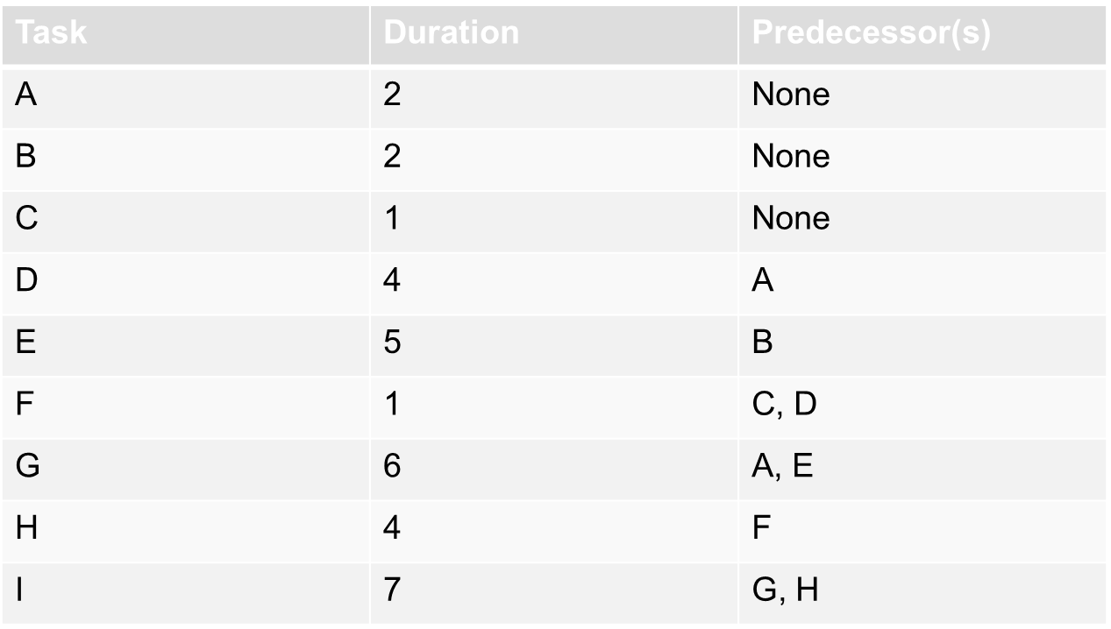
Tasks for Critical Path Exercise

Slide 25
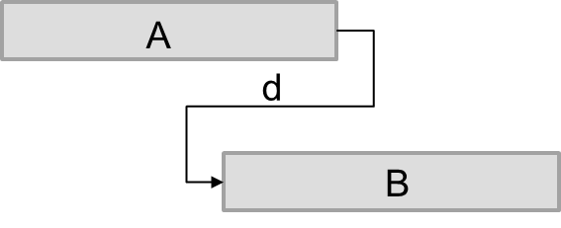
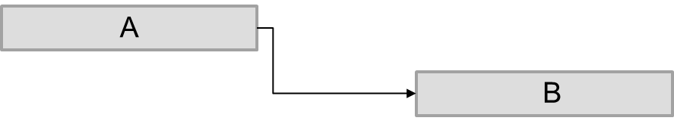
Additional Scheduling Concepts
Task A is a predecessor of task B
Lead time - task B can start d days before task A finished
Lag time – task B can start d days after task A finished
Both can be measured in number of days or in %completed

Slide 26
Critical Chain Scheduling
A method of scheduling that focuses on resources: it considers limited resources when creating a project schedule and includes buffer to protect the project completion date
Uses the Theory of Constraints (TOC) - a management philosophy developed by Eliyahu M. Goldratt

Slide 27
Buffer and Critical ChaiN
A buffer is additional time to complete a task
Murphy’s Law states that if something can go wrong, it will
In traditional estimates, people often add a buffer to each task and use it wheather it is needed or not
Parkinson’s Law states that work expands to fill the time allowed
Critical chain scheduling removes buffers from individual tasks and instead creates a buffer at the project’s level
https://www.youtube.com/watch?v=mpc_FdAt75A

Slide 28
Repercussions of Multitasking
Multitasking - when a resource works on more than one task at a time
Task completion is delayed with multitasking
Added time of “switching context”
We want to minimize multitasking

Slide 29
“You can do two things at once, but you can't focus effectively on two things at once.”
— Gary Keller

Slide 30
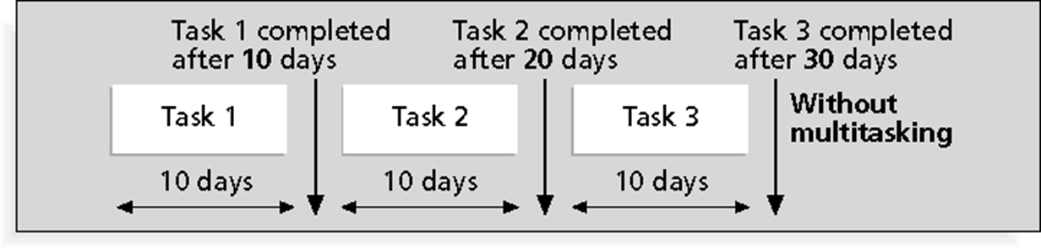
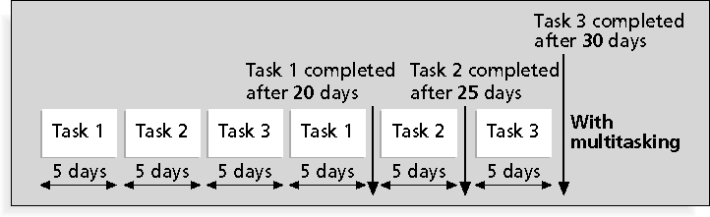
Multitasking EXAMPLE
Schwalbe 2018

Slide 31
Project Cost Management
Project cost management includes the processes required to ensure that the project is completed within an approved budget
A 2011 study published in Harvard Business Review examined almost 1,500 IT projects and reported an average cost overrun of 27%
How to deliver effective cost management: https://www.youtube.com/watch?v=7bXcc7AYajo

Slide 32
4 Steps in Project Cost Management
Resource planning
Cost estimation
Detemining the Budget
Cost control
Project Cost Management: Steps, Basics and Benefits

Slide 33
Cost Management Plan
A cost management plan is a document that describes how the organization will manage cost variances on the project
A large percentage of total project costs are often labor costs, so project managers must develop and track estimates for labor (often measured in FTE – full-time equivalent)
Important to distinguish between internal and external resources (labour cost higher for contractors)

Slide 34
Cost Estimation techniques
Top-down estimates: use the actual cost of a previous, similar project as the basis for estimating the cost of the current project (analogous)
Bottom-up estimates: involve estimating individual work items or activities and summing them to get a project total
Parametric modeling uses project characteristics (parameters) in a mathematical model to estimate project costs, e.g. COCOMO (Constructive Cost Model)
Function points – measuring software size based on what the software does to end users: inputs, outputs, inquiries, internal data, external interface data (metric developed in the 1970s and made international standard)
Lines of code

Slide 35
Problems with IT Cost Estimates
Estimates done before having clear system requirements
Lack of estimating experience
Bias toward underestimation
Management asks for an estimate but needs more accurate number for a bid; if the estimate will be the basis for contract awards and performance reporting, it needs to be a definitive estimate and as accurate as possible

Slide 36
Determining the budget
Cost budgeting involves allocating the project cost estimate to individual work items over time
The WBS is a required input to the cost budgeting process since it defines the work items
Important goal is to produce a cost baseline - a time-phased budget that project managers use to measure and monitor cost performance

Slide 37
MS Project Demo Continued
Critical path
Project’s baseline
Tracking Gantt
Cost estimate

Slide 38
Introducing Group Assignment 2

